Slide 1
Convolutional Neural Networks (CNNs)
(An introductory course)
NAAMII Winter School in AI, December 13th, 2019 Pokhara
Ajad Chhatkuli Computer Vision Lab @ ETH Zurich, NAAMII

Slide 2
Vision
It’s not just about the eye, the mere sensor
Human Vision is done in the brain!

Slide 3
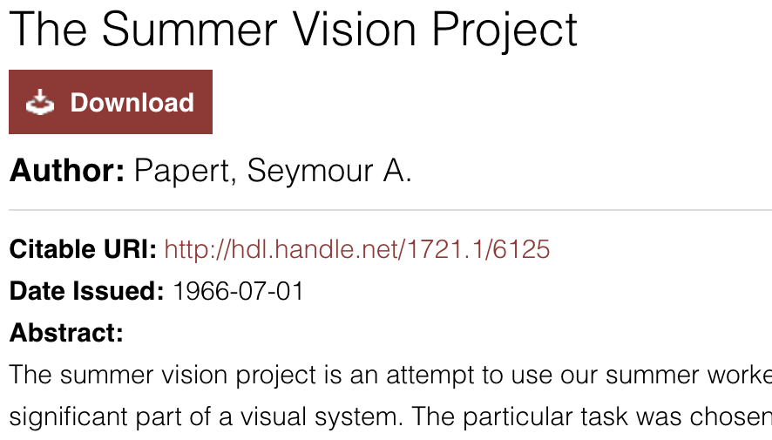
Artificial Intelligence for Vision
Pattern Recognition
objects
construct a system of programs
background areas and chaos
Object Identification
Still an open problem, after > 50 years!!
Bishesh Khanal and Ajad Chhatkuli. Second Nepal Winter School in AI. 2019

Slide 4
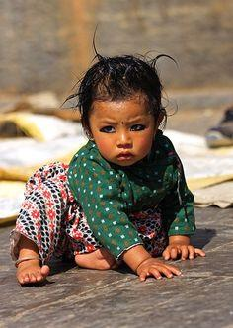
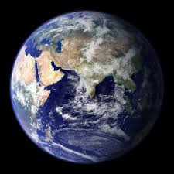
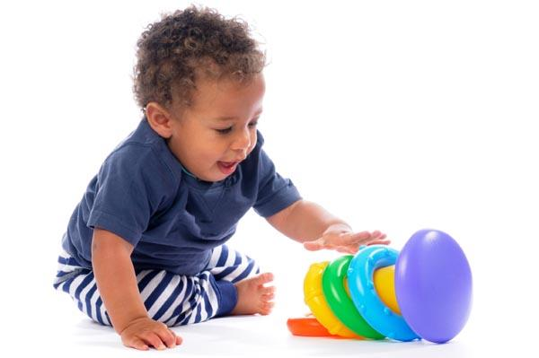
How do we learn to see ?
We move in order to see and see in order to move- William Gibson
We live in the real world
[source: Traveltourtrek Nepal]
Three pillars of AI - data, learning and knowledge
-Fei Fei Li
Bishesh Khanal and Ajad Chhatkuli. Second Nepal Winter School in AI. 2019

Slide 5
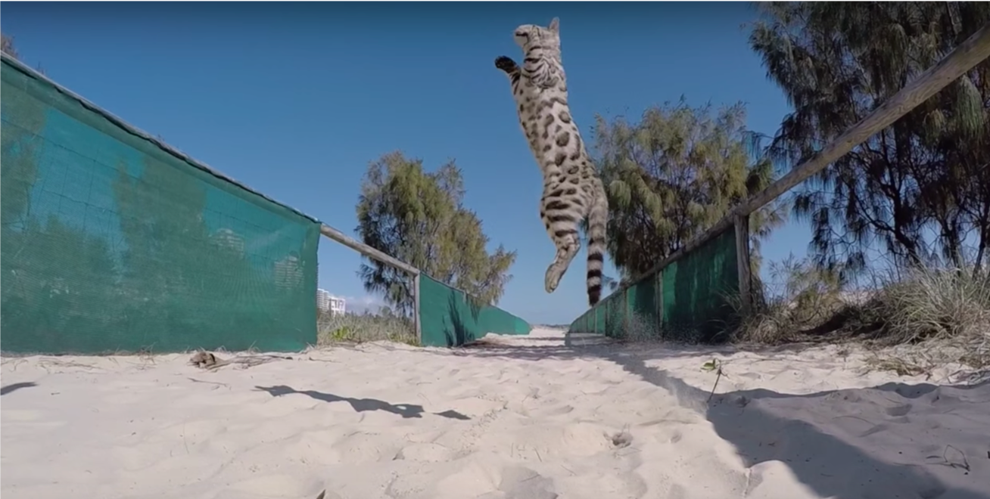
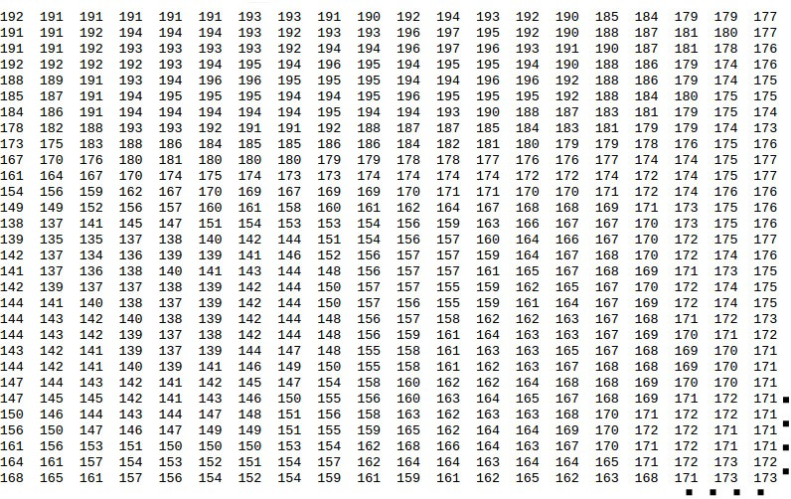
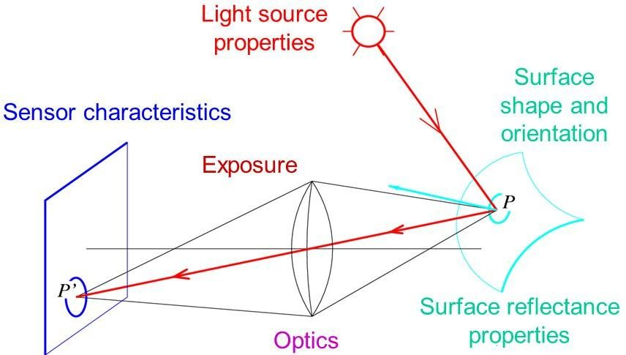
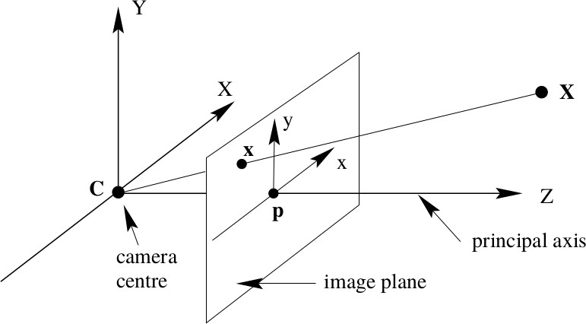
Image Formation
What we see
What machines see
Source: Hartley, Richard, and Andrew Zisserman. Multiple view geometry in computer vision. Cambridge university press, 2003.
Source: L. Fei Fei

Slide 6
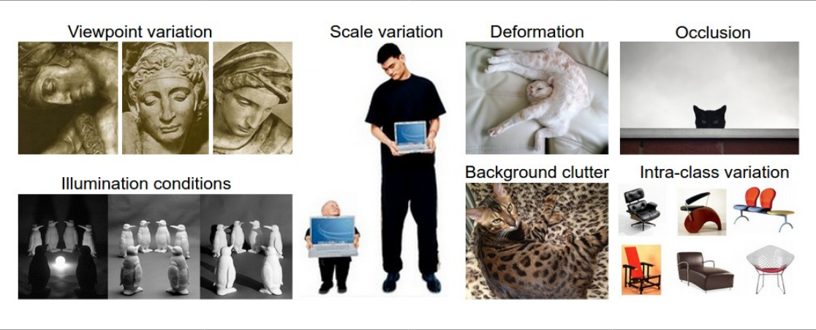
Challenging conditions
Source: http://cs231n.github.io/classification
Bishesh Khanal and Ajad Chhatkuli. Second Nepal Winter School in AI. 2019

Slide 7
Image: Function of Multiple Spatial Variables
Computers just see numbers (in fact, a lot of numbers)
2D image: each discrete position (x , y ) consist of intensity values
3D image: each discrete position (x , y , z ) consist of intensity values
grayscale images represented as N × M matrix
color images (R,G,B) represented as 3 × N × M matrix
Bishesh Khanal and Ajad Chhatkuli. Second Nepal Winter School in AI. 2019

Slide 8
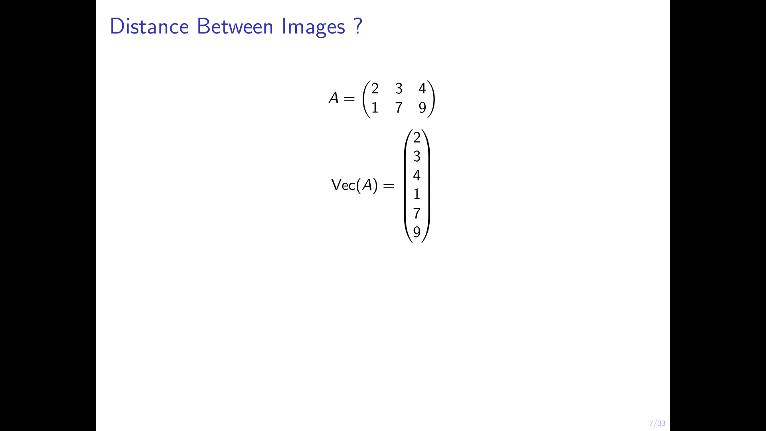
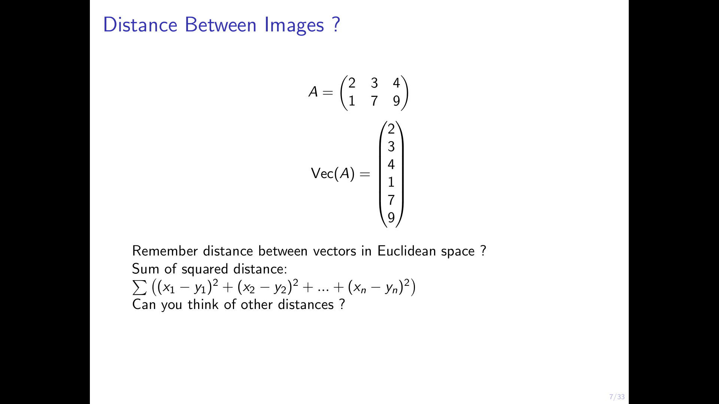
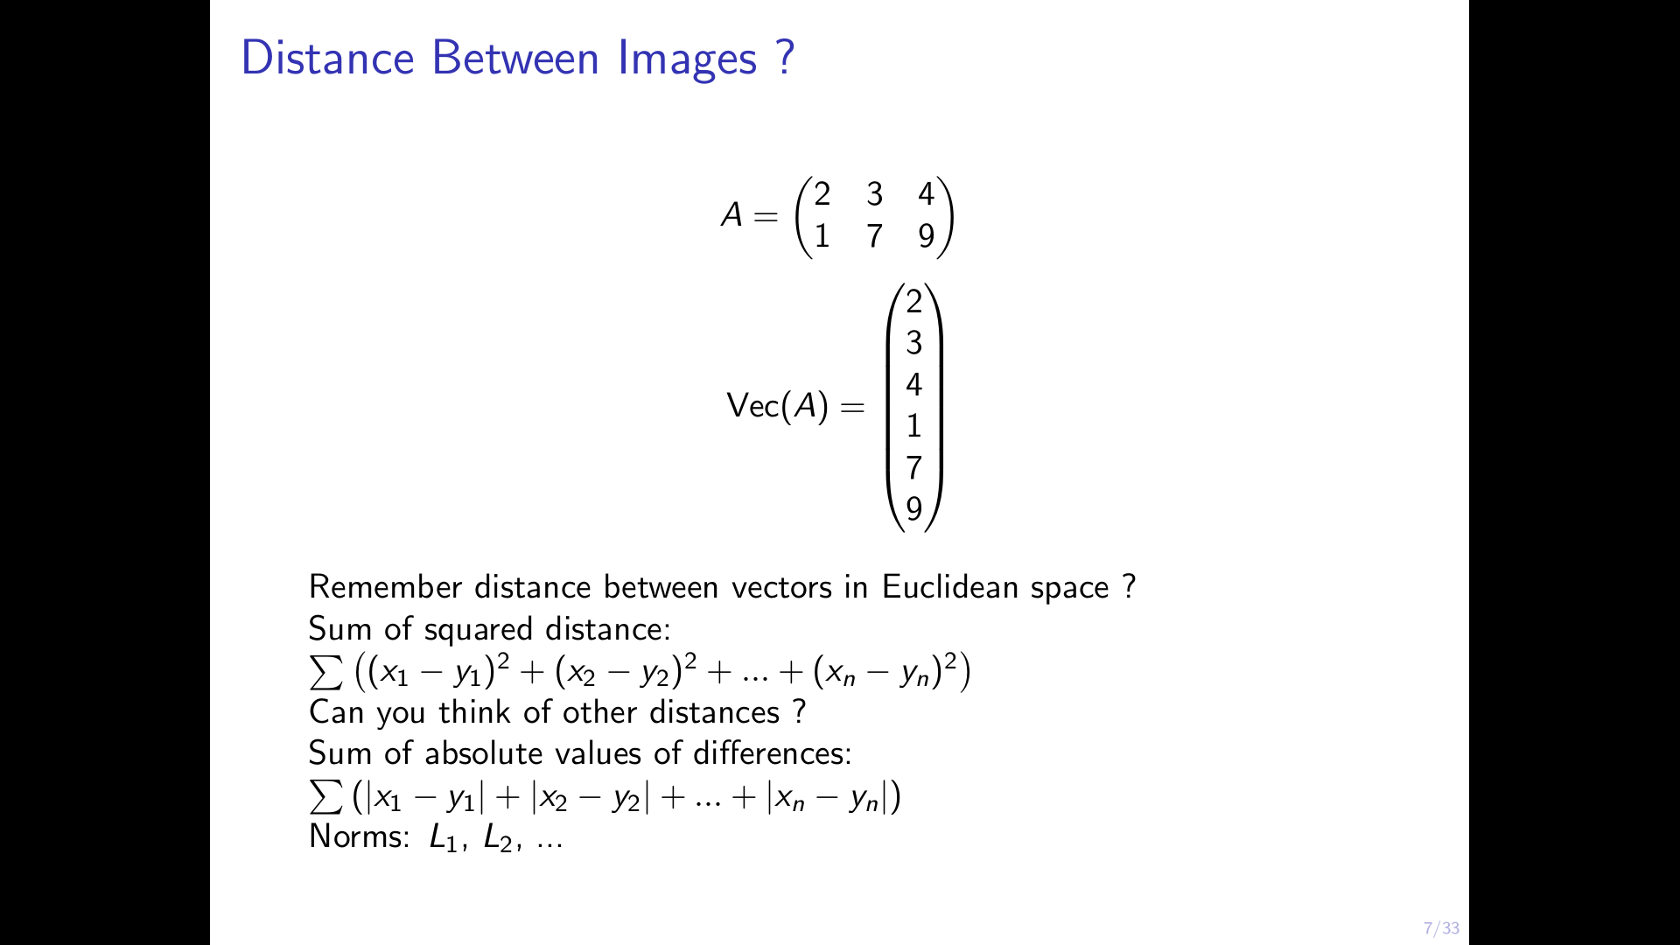
Distance Between Images ?

Slide 9
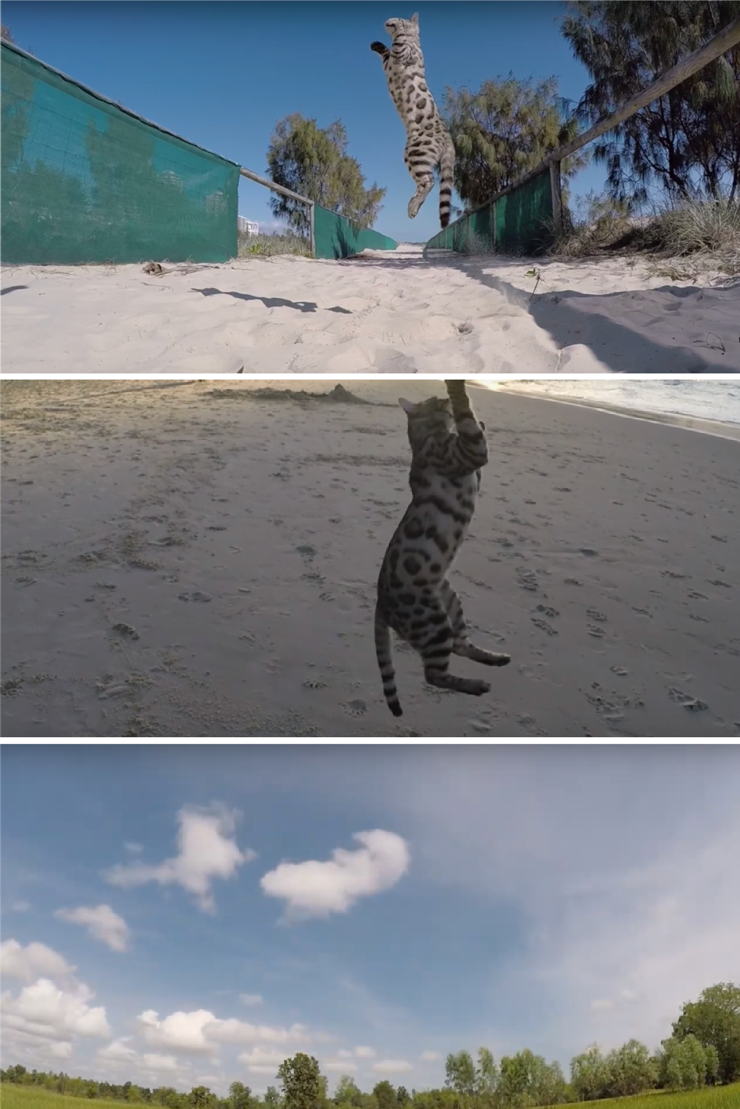
Two Closest images ?
Based on SSD, Kitten images are further apart!
Euclidean space not suitable in most cases for images
Better representation ? what manifold do the images lie ? Better metric “distance”

Slide 10
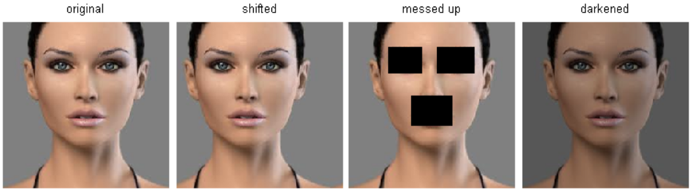
Equidistant Images in Euclidean Space
Source: http://cs231n.github.io/classification

Slide 11
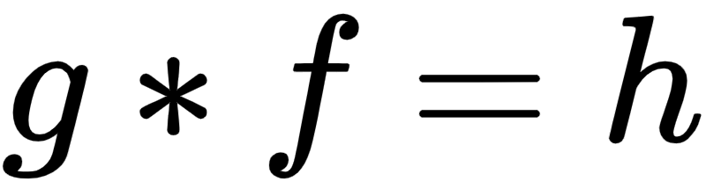
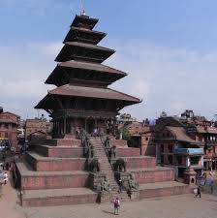
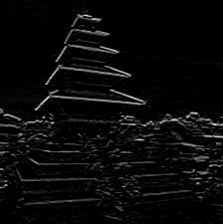
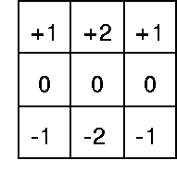





Convolutions
A function g modifies f such that:

Slide 12

Convolutions

Slide 13
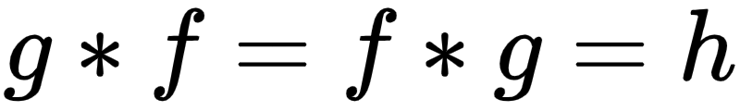
Convolutions
A function g modifies f such that:

Slide 14

@ CVL, ETHZ

Slide 15
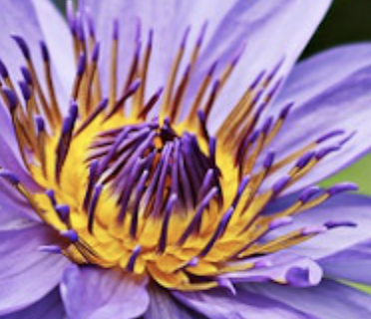

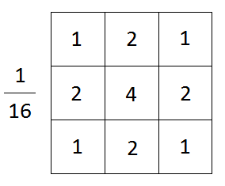
Convolutions
Gaussian filter

Slide 16
More filters
Sobel filters

Slide 17
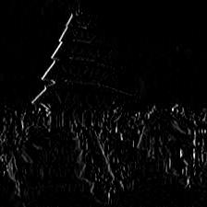
Because once is not enough
Sobel filters

Slide 18
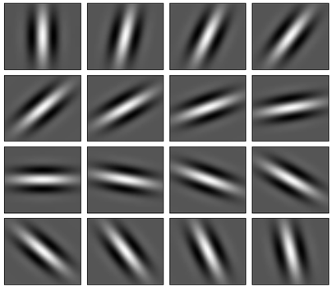
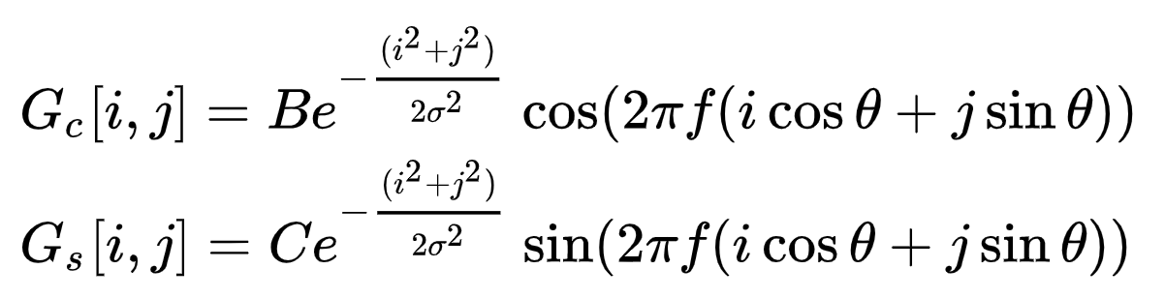
Even more filters
Gabor filters
Gaussian filters modulated by sinusoidal signal of different orientations

Slide 19
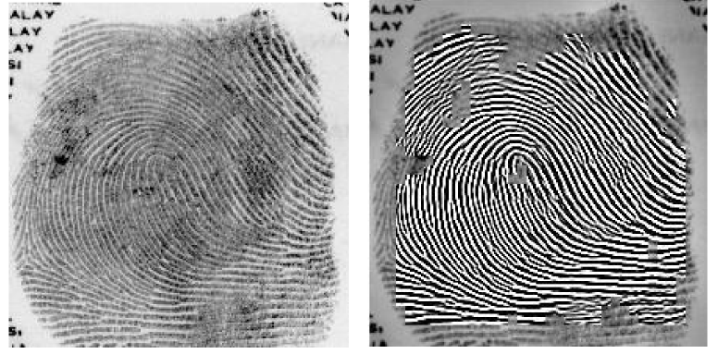
Eureka!
[A. K. Jain et al. 1998]

Slide 20
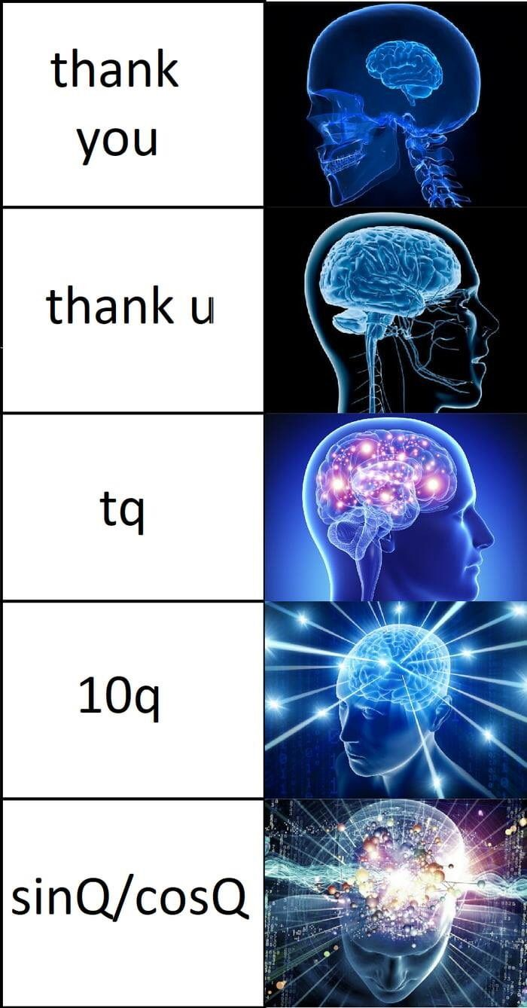
Loosely linked to the human brain
Gabor filters
V1 Cells in the Visual Cortex => like Gabor filters

Slide 21
Features
Features/ feature maps
Filters
Filters
Filters
What filters =
What patterns do you want the machine to recognize?

Slide 22
The classics
Convolutions can be applied to obtain good features
Handcrafted rules
Input Image
Filters
Features
Output
Linear/Logistic Regression
PCA/ LDA

Slide 23

Here comes the CNN!
Optimize the filters until the Output is good!
Filters
Features
Output
Linear/Logistic Regression

Slide 24
Here comes the CNN!
Optimize the filters until the Output is good!
Filters
Filters
Feature Maps

Slide 25
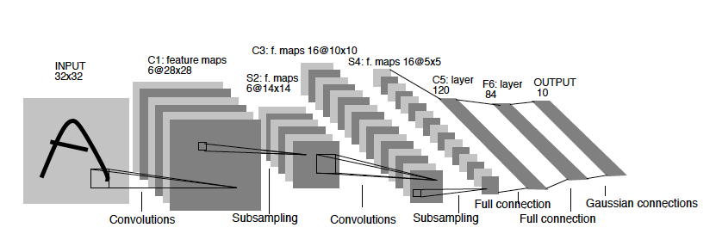
Yan LeCun’s CNN

Slide 26

The Devil is in the Details
Mask (Kernel)
Size
Stride
Dilation => relationship between distant pixels
Pooling
Width and Depth

Slide 27
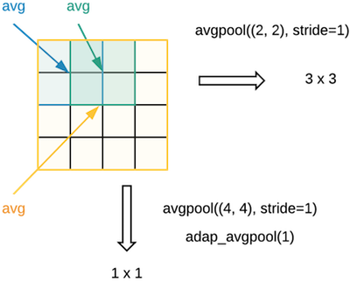
Dimension reduction
Average Pooling
Max Pooling
Non-linearity

Slide 28
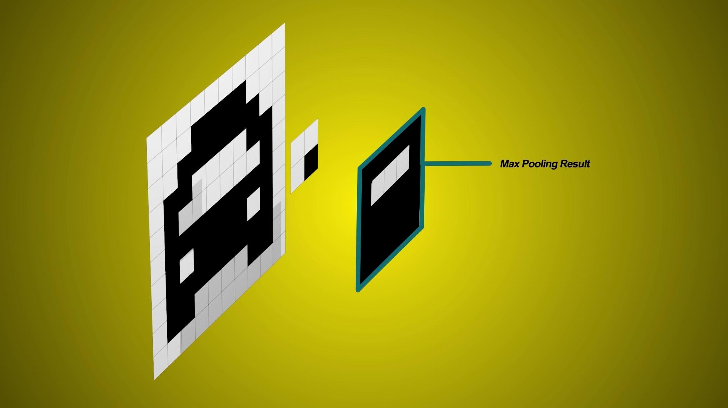
@ CVL, ETHZ

Slide 29
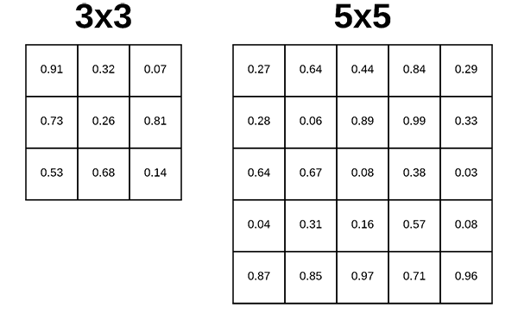
Kernel size / Mask size
Kernel size / Mask size
Number of parameters
Size of the receptive field
Computational cost

Slide 30
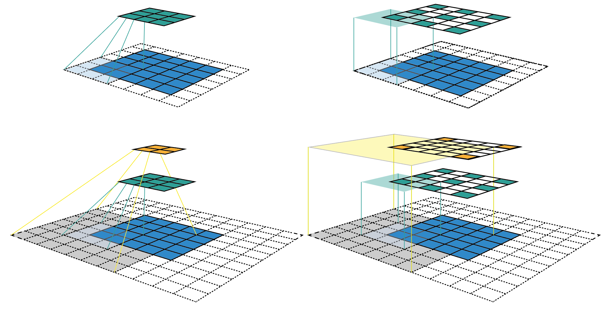
Kernel size and the receptive field
Kernel size / Mask size
[medium.com]

Slide 31


Dilation filters
Computation
Receptive field
[medium.com]

Slide 32
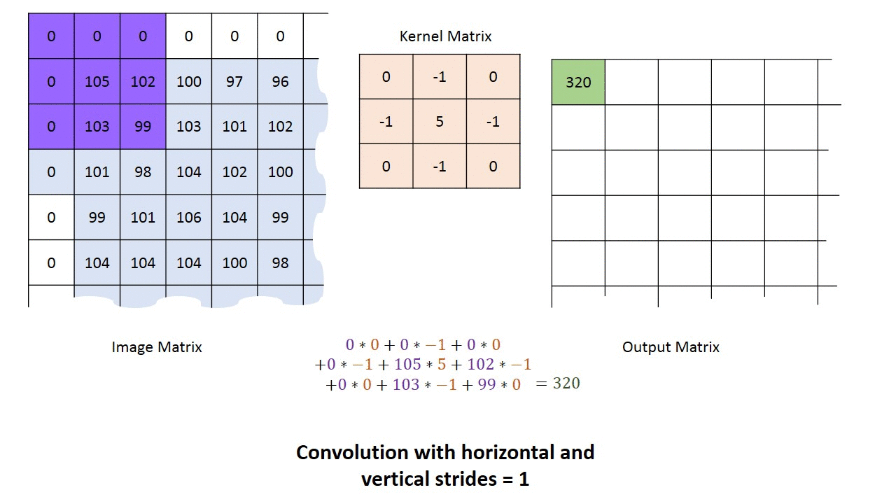
Padding and Stride
Padding
Add 1’s or 0’s around the border
Stride
Sliding window jumps s steps

Slide 33
Summary
Kernel
Stride
Padding
Pooling
Dilation
Source: towardsdatascience.com

Slide 34
Summary
Kernel
Stride
Padding
Pooling
Dilation
Source: towardsdatascience.com

Slide 35
Q & A (Not a Break)
torch.nn.

Slide 36
Width and Depth (Channels and Layers)

Slide 37

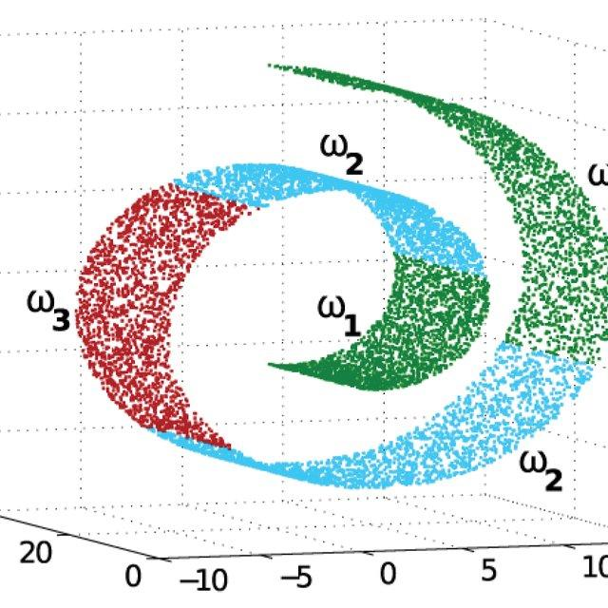
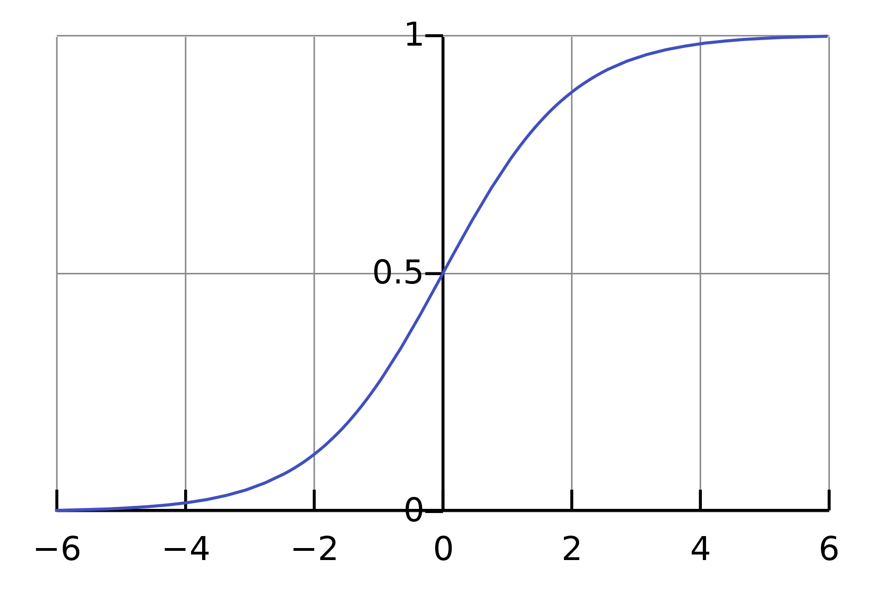
Activations
Convolutions are linear operations
Feature Maps

Slide 38
What is a layer?
Convolution output
Filters
Filters
Filters
Filters
Activation
Convolution
Pooling
Single layer output

Slide 39
A CNN Encoder
An encoder encodes an image into low dimensional features

Slide 40
Aggregating global features
Fully connected layer

Slide 41
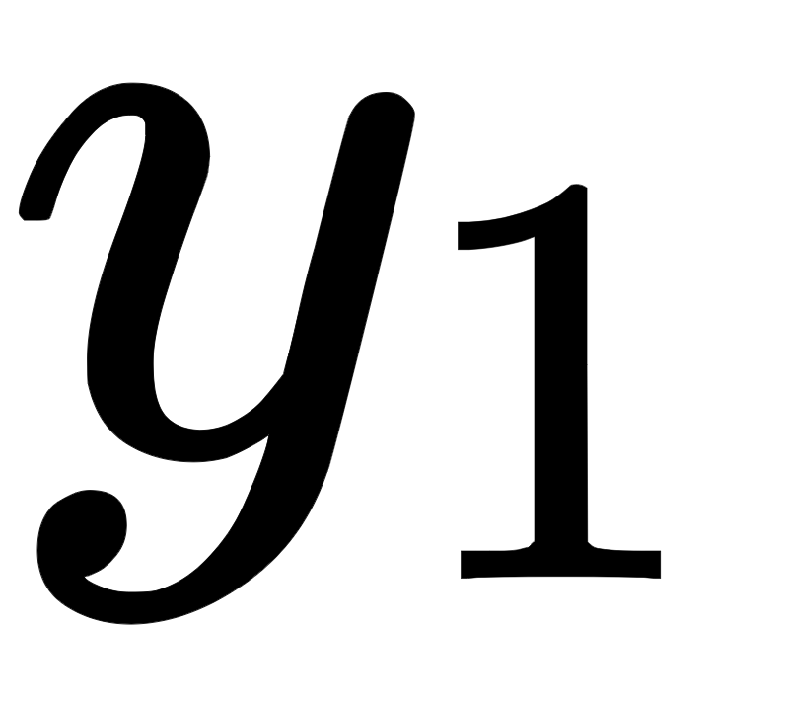
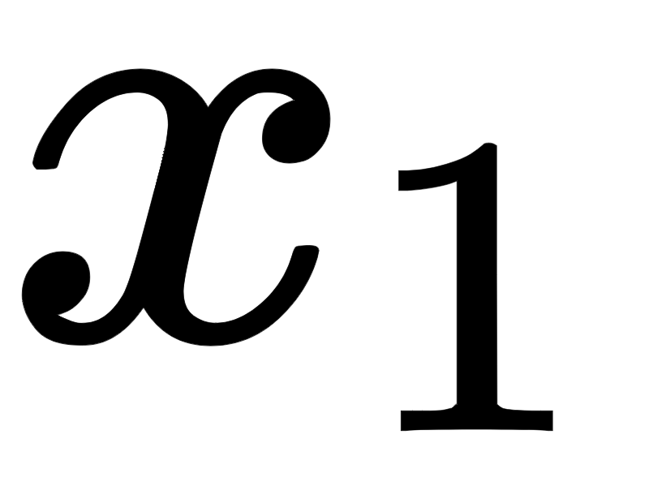
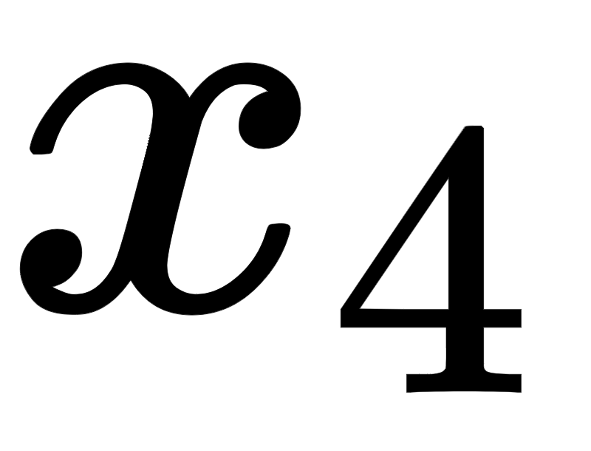
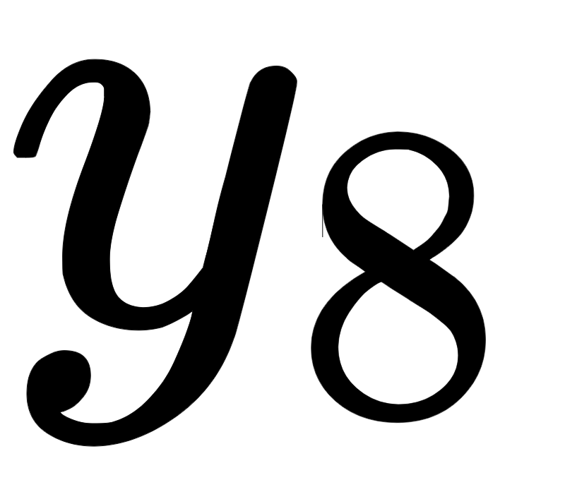
How to use an encoder
Fully connected layer

Slide 42
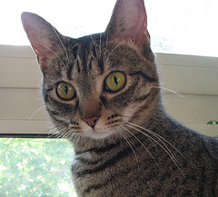
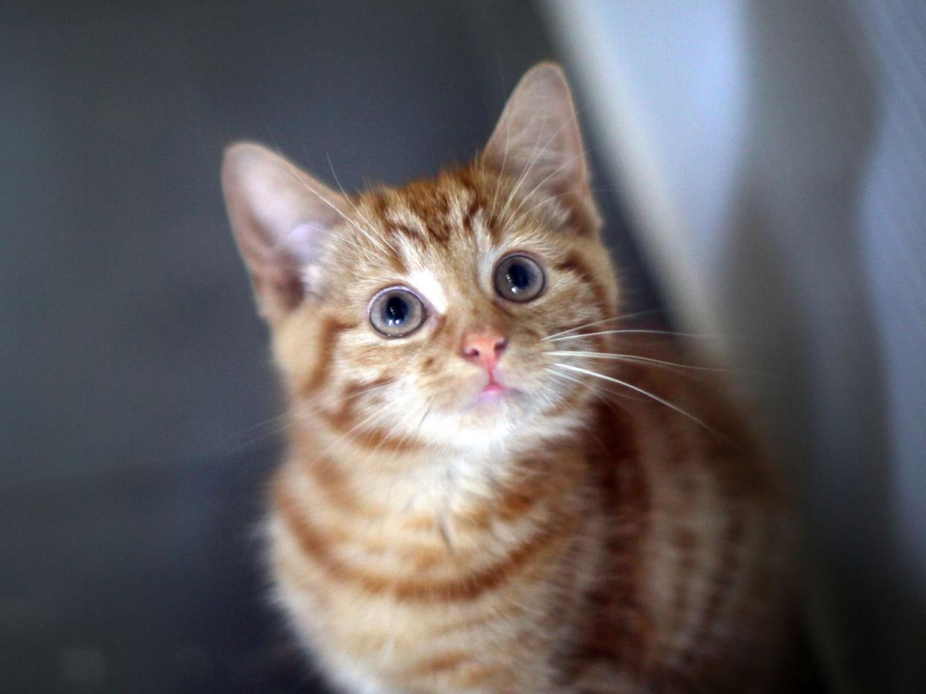
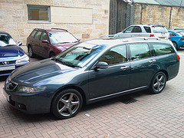
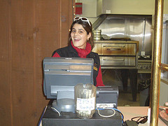
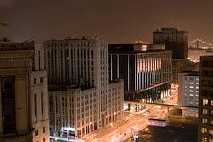
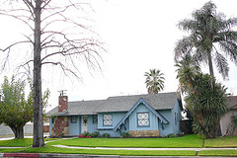
Image Classification
Car
Cat

Slide 43
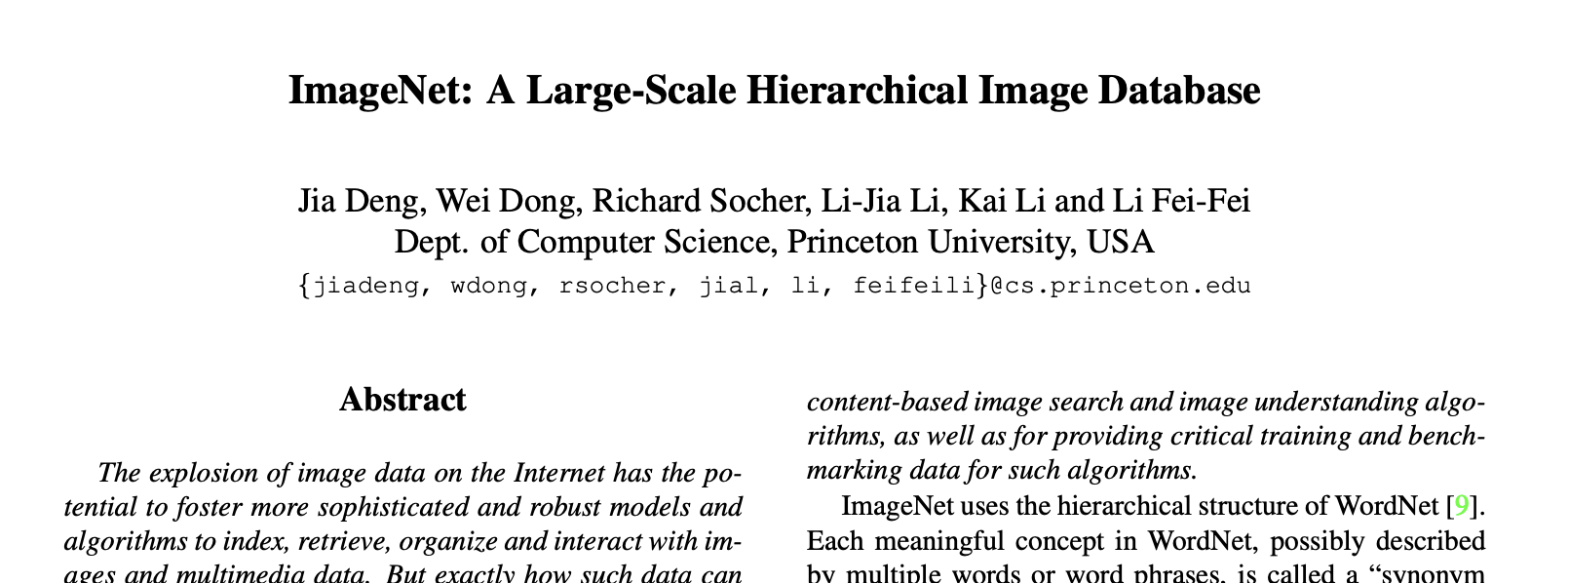
ImageNet Classification Challenge
Accuracy of methods < 50%

Slide 44
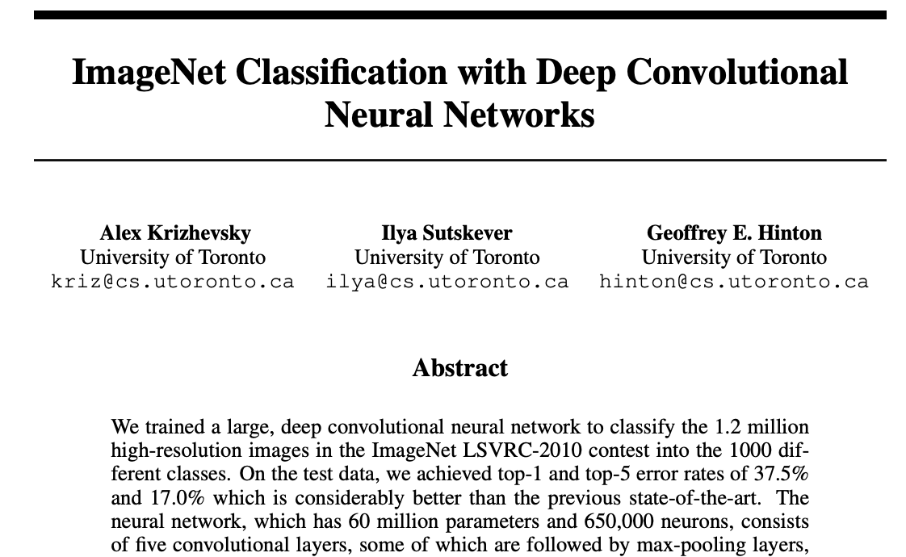
AlexNet

Slide 45
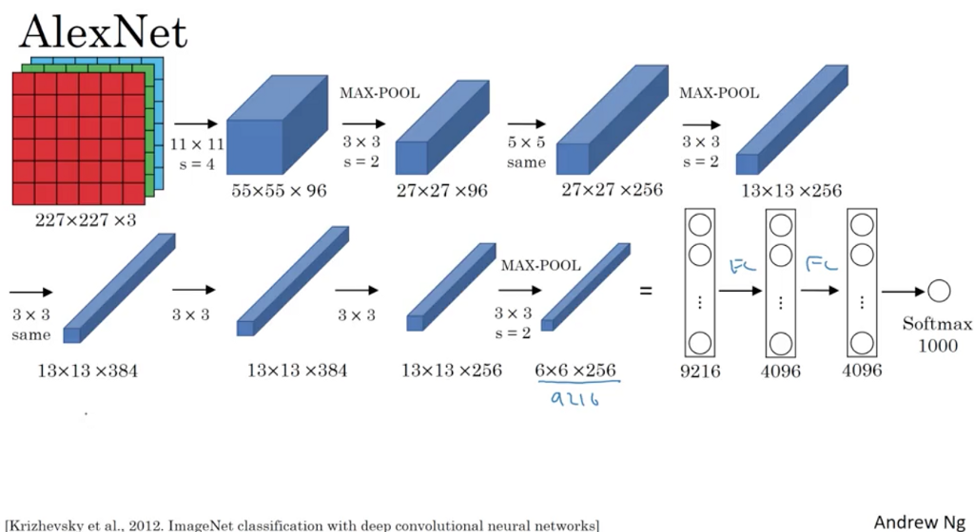
AlexNet

Slide 46

Encoder + SoftMax
@ CVL, ETHZ

Slide 47
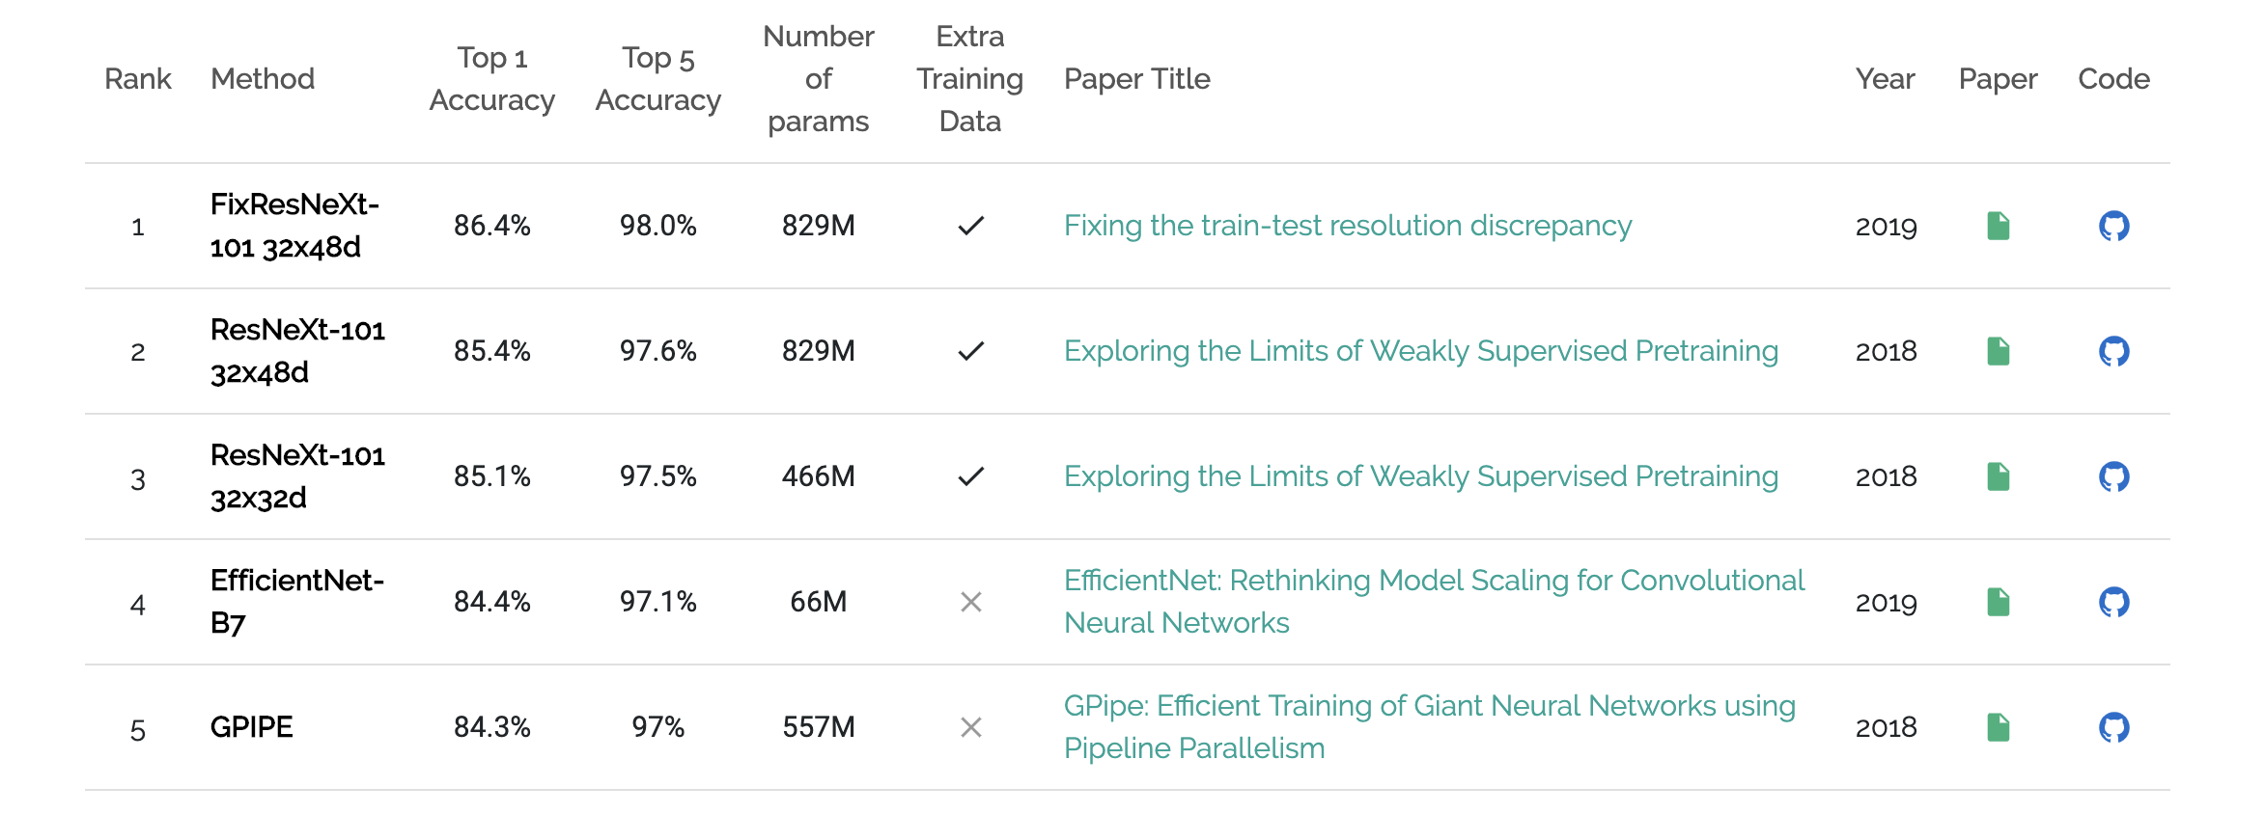
Image Classification
https://paperswithcode.com/sota/image-classification-on-imagenet

Slide 48
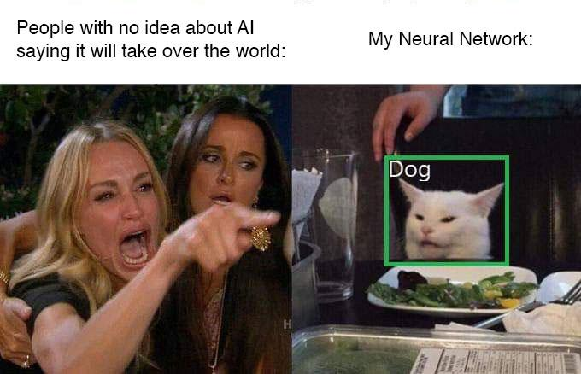
Still not perfect!

Slide 49
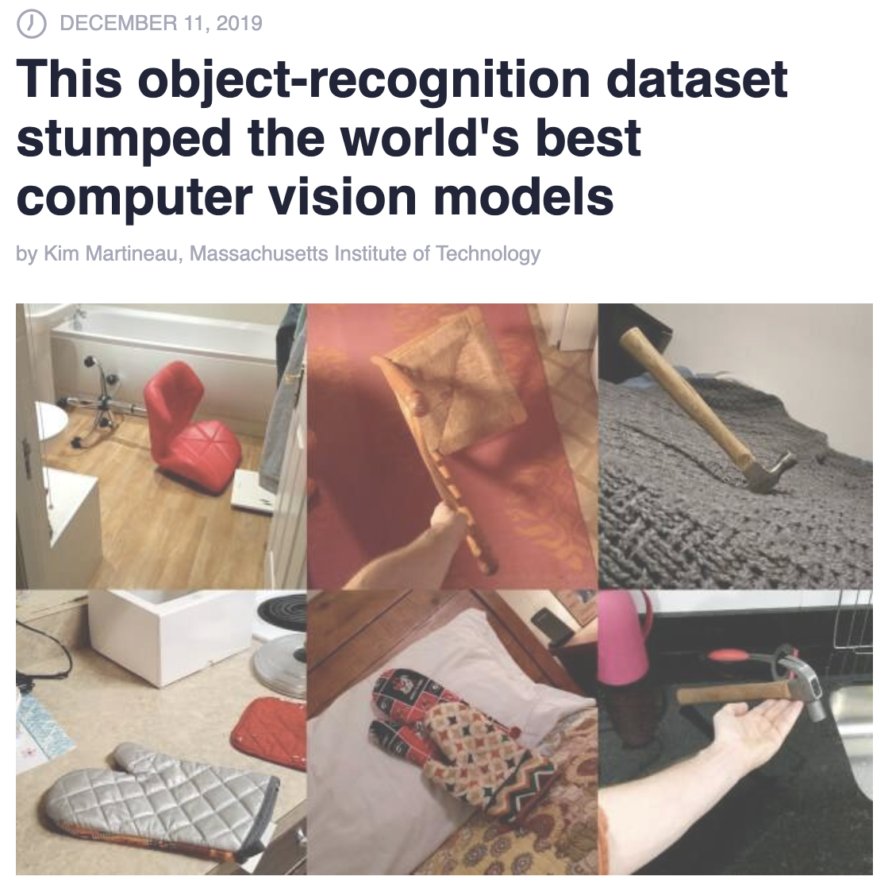

Slide 50

Is it an attention problem?

Slide 51

Is it an attention problem?

Slide 52

Image Classification
Why do I want to know if it is a cat?
Source: internet?

Slide 53

Image Classification
Why do I want to know if it is a cat?
1 GPU > 1500$

Slide 54
Image similarity: Face recognition
Machine learns to understand what cats looks like.
vector_1
vector_2

Slide 55

Deconvolutions
Perform Upsampling!
https://github.com/vdumoulin

Slide 56




Auto-Encoder
Bottleneck
Encoder
Decoder

Slide 57
Convolutional Neural Network
Architecture
Convolution => Pooling => Activations
Encoder architecture
Image Classification
Decoder:
Deconvolution => Pooling => Activations
Example: Image segmentation
U-Net Architecture
Skip Connection

Slide 58

Transfer Learning
ImageNet Classification
Network
vector_1
YOLOv3
Transfer weights
ImageNet Classification
Network
Extra layers

Slide 59
CNN applications
Different approach
Classification
Regression
Tasks
Depth
Normals
Saliency

Slide 60
Pytorch Coding
Tutorial: Image Classification

Slide 61

Skip Connections
Residual Network Blocks
Handles Exploding gradients

Slide 62

Image Segmentation
Source: CityScapes

Slide 63


Slide 64

Example: U-Net
Information flow: use skip connection

Slide 65


Slide 66


Slide 67

Learning on Point sets

Slide 68

PointNet

Slide 69
Pointset examples
Locations of events in a day
Sales statistics
No order of elements in a data point.

Slide 70
Image Classification Example:
6
2,2
12
2,2
24
2,2
64
2

Slide 71
Tutorials
self.conv1 = nn.Conv2d(in_channels=3, out_channels=6, kernel_size=3, padding=1, bias=False)
self.pool1 = nn.MaxPool2d(kernel_size=2, stride=2)
6
2,2

Slide 72
Tutorials
Image Classification

Slide 73
Things we could not cover
Recurrent Neural Networks (RNNs)

